Slide 1


Stepping into the World of BlockChain

Slide 2



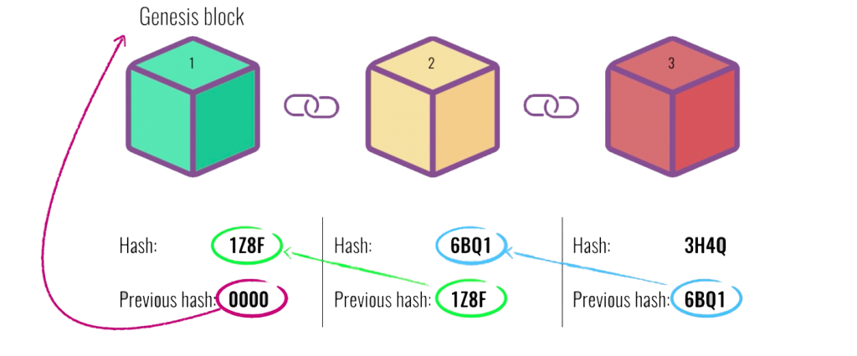
Team
Mentor
Speaker
Block
Chain
Hammad Ahmed
Executive Council
Technical – Lead
CS – 19th batch
Abdulwadood Waseem
Technical – dept.
Head Cloud
AI – 20th batch

Slide 3
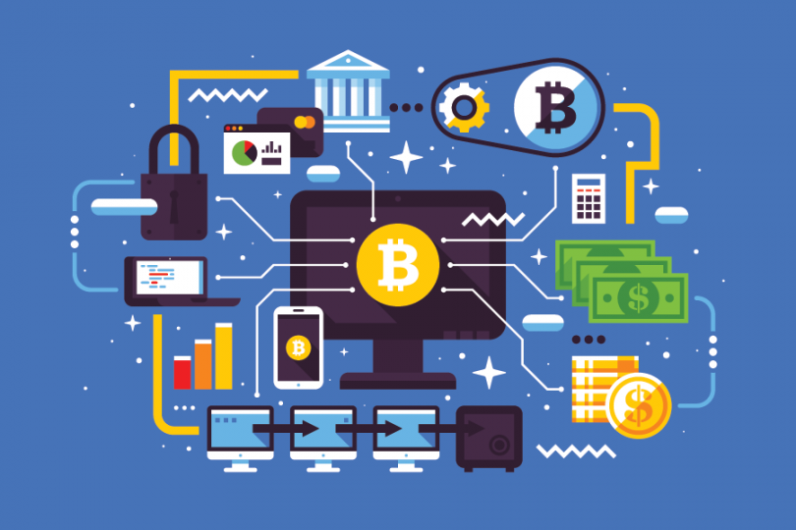
What is Block Chain?
System of recording information in a secure manner.
Difficult or Impossible to change, hack, or cheat the system.

Slide 4
Background
Cryptographer David Chaum first proposed a blockchain-like protocol in his 1982 publication. Further work on a cryptographically secured chain of blocks was described in 1991 by Stuart Haber and W. Scott Stornetta.
The first blockchain was conceptualized by a person (or group of people) known as Satoshi Nakamoto in 2008. Nakamoto improved the design in an important way using a Hashcash-like method to timestamp blocks. Till date, nobody knows who was/were Satoshi Nakamoto.

Slide 5
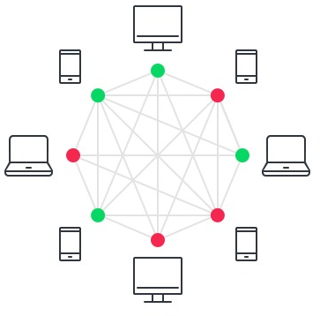
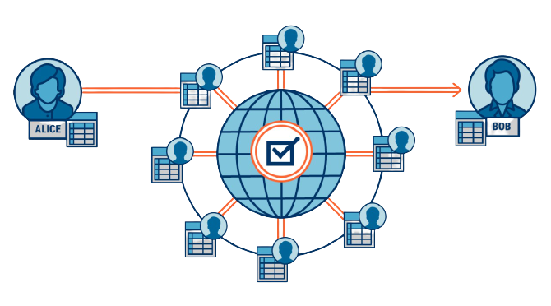
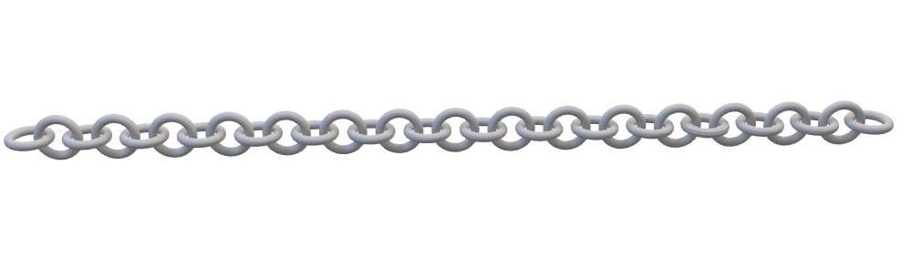
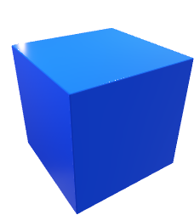
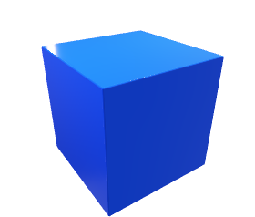
Components:
Block
Chain
Node
Ledger

Slide 6
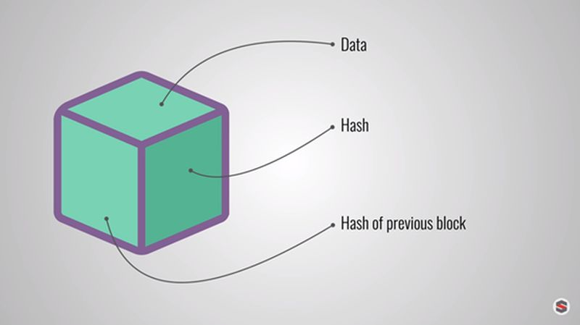
Block
Data:
To: abc
From: xyz
Amount: 2₿
Amount: 3₿
Hash
Unique Id assigned to new Block.
Ex. WTFOIJphu5984FEW4988OMG
Ex. WTFOIJphu5984FEW4984FWF

Slide 7
Chain
genesis block
Data: ….
Hash: 4XBG
Previous Hash: 0000
Data: ….
Hash: 3LFK
Previous Hash: 4XBG
Data: ….
Hash: 85KS
Previous Hash: 3LFK
Hash: 2L6F

Slide 8
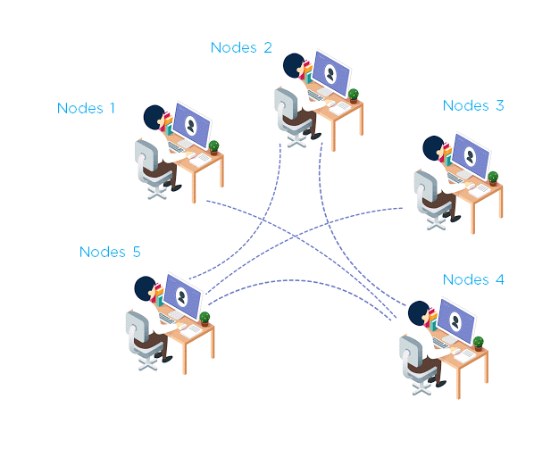
Node
The computers and systems that store the blockchain data are called nodes.
Importance
Transaction validation
Data storage
Replicate the transaction

Slide 9
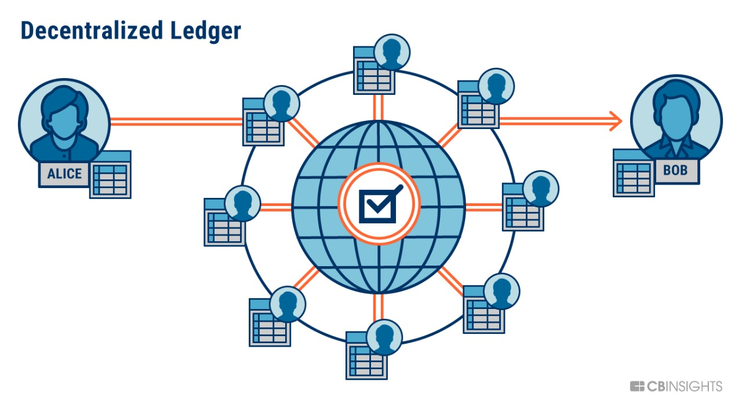
Ledger
It is an organized collection of information, and nodes all across the blockchain network has a copy of it.
Name | Public Key | Balance
Maaz | XXXX-XXXX | 24
Noor | YYYY-YYYY | 10
Shehryar | ZZZZ-ZZZZ | 08
Name | Public Key | Balance
Maaz | XXXX-XXXX | 22
Noor | YYYY-YYYY | 12
Shehryar | ZZZZ-ZZZZ | 08

Slide 10
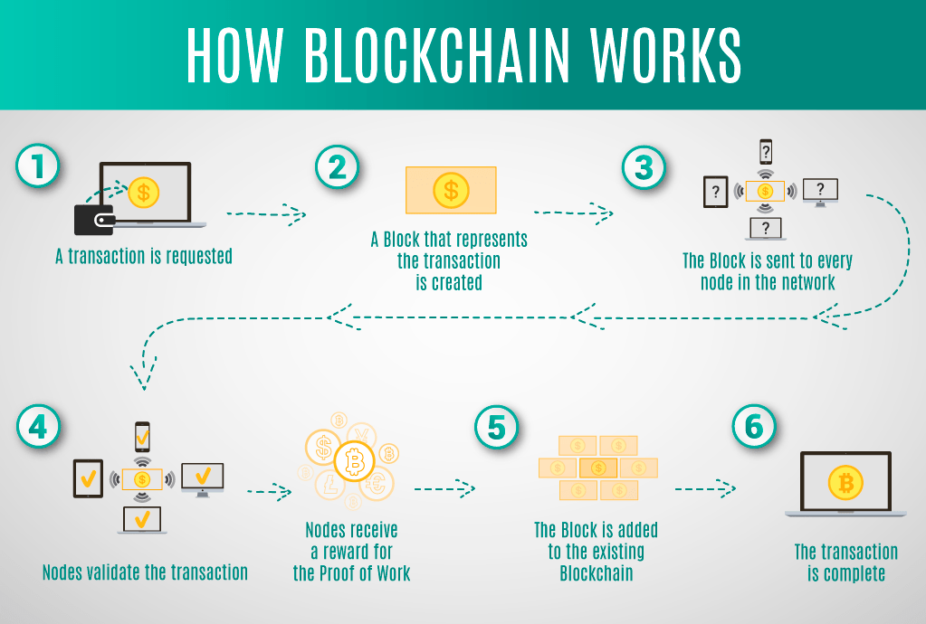

Slide 11
Why Blockchain?
 | Database | BlockChain
Type | Permissioned | Public / openness /permissionless
Data persistence | non-persistence | Immutable / Un-hackable
Control | Centralized | Decentralized
Chance of failure | Yes | No
Architecture | Client-Server architecture | P2P (Peer to Peer) architecture

Slide 12
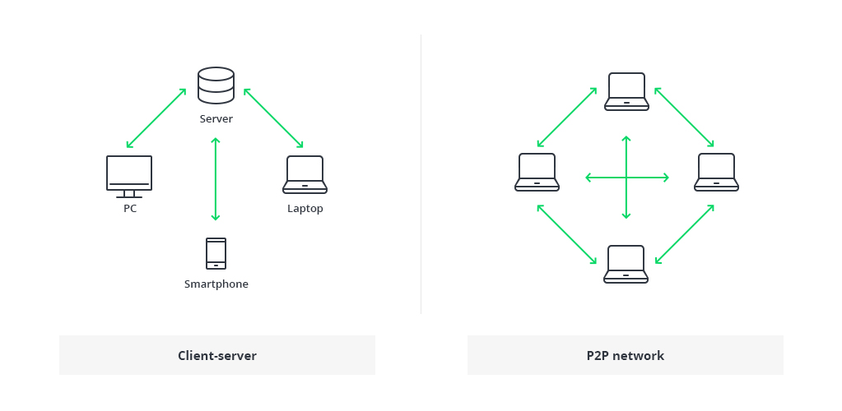
Architecture

Slide 13
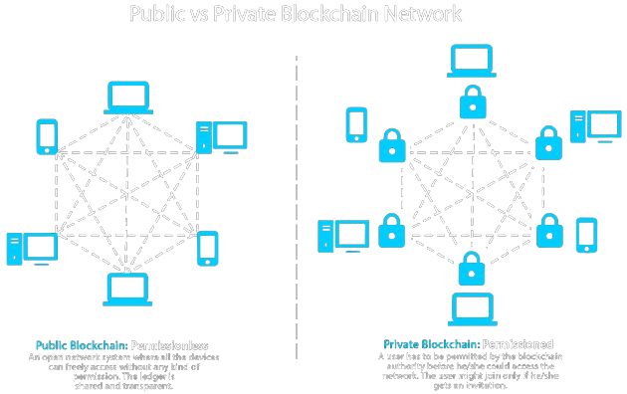
Types Of Blockchains
Private blockchains
Permissioned
Centralized
Invite only access
Public blockchains
Permissionless
Decentralized
Anyone on the internet can access

Slide 14
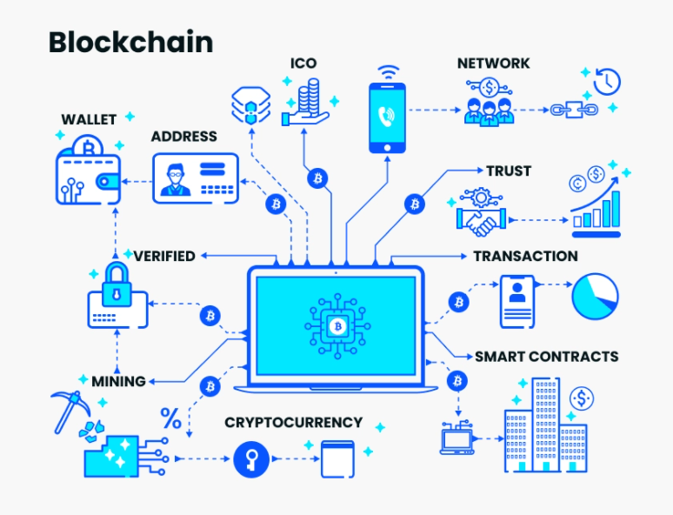
Application
Cryptocurrency
Smart Contracts
Supply Chain
Financial Services
Video Games
and many more…

Slide 15

Cryptocurrency
Virtual Currency
Decentralized
No transaction limits
Minimal transaction fees
Lighting transactions
Much secure transactions

Slide 16
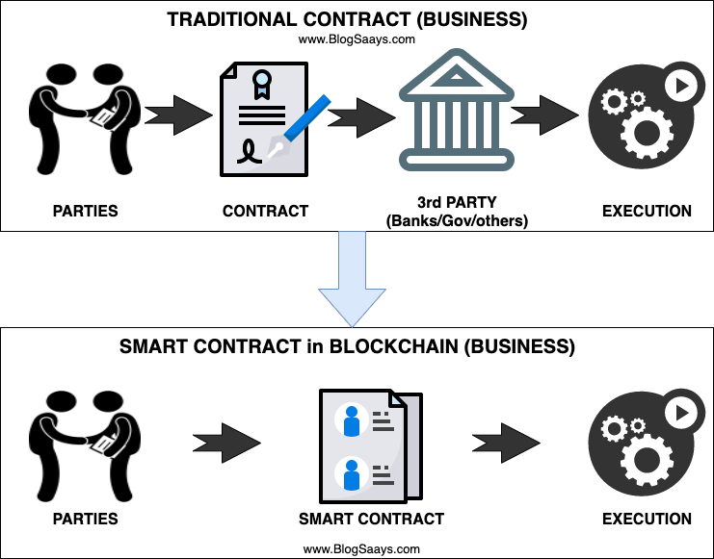
Smart Contracts:
Smart Contracts are simple programs on the blockchain that automate agreements by executing when predetermined conditions are met.
Importance:
Speed, Efficiency and Accuracy
Trust and Transparency
Security

Slide 17
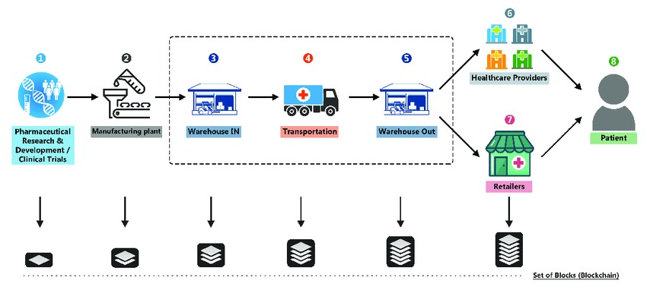
Supply Chain
Companies use blockchain to keep a track of their product's quality and any issues that arrive in the supply chain.

Slide 18
Darkside
Monetary transactions and digital divide
Can Start Currency Wars
Can Lead to Complete Decentralized System
High Energy consumption
Immutable
Expensive and complicated
Expert knowledge is required

Slide 19
References:
https://www.euromoney.com/learning/blockchain-explained/what-is-blockchain
https://builtin.com/blockchain
https://www.researchgate.net/publication/318131748_An_Overview_of_Blockchain_Technology_Architecture_Consensus_and_Future_Trends
https://scet.berkeley.edu/wp-content/uploads/BlockchainPaper.pdf
https://www.buffalo.edu/content/dam/www/ubblockchain/files/basics/001%20What%20is%20Blockchain.pdf
https://slid.cc/set_cookie

Slide 20


Slide 21
Q&A

